Slide 1
ZONK!
Lab Safety
Edition

Slide 2
Directions
Each team will take turns choosing a number. The number can lead to questions worth 5, 10, and 15 points or it can lead to a ZONK or a DOUBLE ZONK.
If a question appears, the team must answer it correctly to earn the points for that question.
If a ZONK appears, the team will lose their turn.
If a DOUBLE ZONK appears, the team will lose their turn and lose 10 points!
When all the questions have been asked, the game is over & the team with the most points wins. Have fun! ☺

Slide 3
1
2
3
4
5
6
7
8
9
10
11
12
13
14
15
16
17
18
19
20
21
22
23
24
25

Slide 4
Great job! Thanks for playing! ☺

Slide 5
10 points What should you do at the conclusion of a lab? Be specific.

Slide 6
At the conclusion of a lab you should clean up your entire area making sure to include the following:
Throw away any trash – check the table and the floor
Dispose of chemicals as directed by your teacher
Return materials to their assigned locations
WASH YOUR HANDS!!!

Slide 7
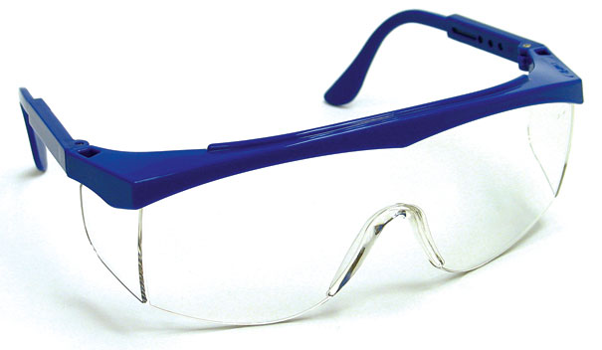
10 points Identify 3 situations that require you to use safety goggles.

Slide 8
3 situations that require you to use safety goggles are:
Any time you work with…
1. heat
2. chemicals
3. sharp objects

Slide 9
10 points What is wafting? When would this technique be used?

Slide 10
Wafting is gently waving air toward your nose with your hand. It should be used any time you need to smell a substance during a lab.

Slide 11
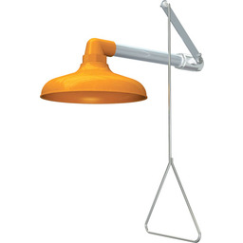
5 points Identify the purpose of the emergency shower.

Slide 12
The emergency shower is used if large amounts of chemicals are spilled onto the skin.

Slide 13
ZONK!
Lose 10 points

Slide 14
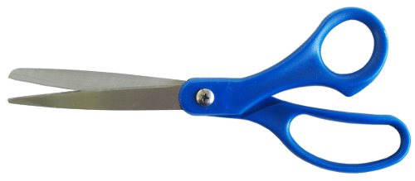
5 points
What is the proper way to carry sharp objects?

Slide 15
Sharp objects should be carried with the sharp end pointed down.

Slide 16
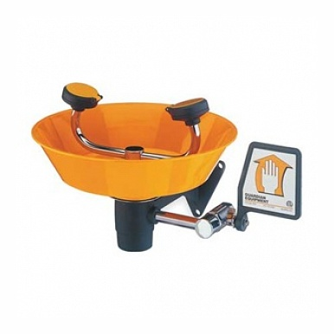
5 points
When using an eye wash station, how long should you flush your eyes with water?

Slide 17
When using an eye wash station, you should flush your eyes with water for at least 15-20 minutes.

Slide 18
5 points
Why is it important to never leave a heat source unattended?

Slide 19
A heat source should never be left unattended because it is a potential fire hazard & it could burn someone.

Slide 20
ZONK!
Lose A turn

Slide 21
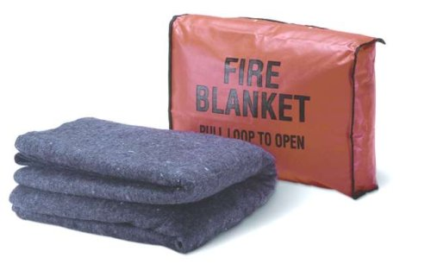
5 points
Identify a situation that would require the use of a fire blanket.

Slide 22
A fire blanket would be used if a person’s hair or clothes catch on fire.

Slide 23
15 points
Identify the safety symbol below. List specific things you should (or should not) do any time you see this for a lab.

Slide 24
This symbol means there is the potential for electric shock. To avoid electric shock, never use electrical equipment around water, or when the equipment is wet or your hands are wet. Be sure cords are untangled and cannot trip anyone. Unplug equipment not in use.

Slide 25
ZONK!
Lose A turn

Slide 26
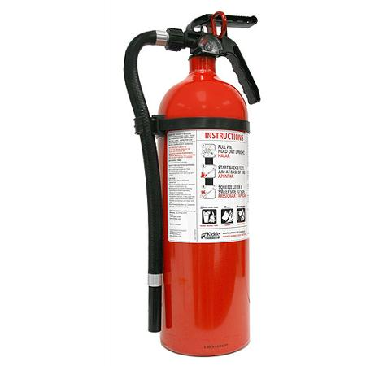
5 points
Identify a situation that would require the use of a fire extinguisher.

Slide 27
A fire extinguisher would be used when a fire is confined to a small area such as a waste basket.

Slide 28
5 points
Why is it not safe to eat in the lab?

Slide 29
It is not safe to eat in the lab because food can become contaminated and cause health risks.

Slide 30
5 points
What should ALWAYS be the first thing you do when starting a lab?

Slide 31
When starting a lab, the first thing you should ALWAYS do is read & understand all directions.

Slide 32
5 points
If there is an accident or injury in the lab, what is the first thing you should do?

Slide 33
If there is an accident or injury in the lab, the first thing you should do is alert the teacher.

Slide 34
5 points
Identify the purpose of the eye wash station.

Slide 35
The purpose of the eye wash station is to rinse the eyes, nose, or mouth in the event of a chemical spill.

Slide 36
5 points
When you are heating a substance in a test tube, which way should you point the test tube?

Slide 37
When you are heating a substance in a test tube, you should point the test tube away from yourself and others.

Slide 38
15 points
Identify the safety symbol below. List specific things you should (or should not) do any time you see this for a lab.

Slide 39
This symbol means you will be working with fumes. Work in a well-ventilated area when harmful vapors may be involved. Avoid inhaling vapors directly. Only test an odor when directed to do so by your teacher, and use a wafting motion to direct the vapor toward your nose.

Slide 40
5 points
Why is it necessary to keep your lab area clean and organized?

Slide 41
It is necessary to keep your lab area clean and organized to reduce the risk of accidents.

Slide 42
5 points
Why should glassware that has been heated NOT be placed directly into cold water?

Slide 43
Glassware that has been heated should NOT be placed directly into cold water because it could break.

Slide 44
ZONK!
Lose 10 Points

Slide 45
15 points
Identify the safety symbol below. List specific things you should (or should not) do any time you see this for a lab.

Slide 46
If you see this symbol, it means you will be working with a corrosive chemical. Avoid getting this chemical on your skin or clothing or in your eyes. Do not inhale the vapors & wash your hands immediately after the lab.

Slide 47
5 points
Where should you point the nozzle of a fire extinguisher in order to properly put out a fire?

Slide 48
You should point the nozzle of a fire extinguisher at the base of the flame.

Slide 49
ZONK!
Lose A Turn

Slide 50
Thank You!
Thank you so much for your download. I truly appreciate your business & I am so excited that you have decided to share my lesson with your students.
Please stop back at my store & let me know how everything went!
http://www.teacherspayteachers.com/store/Science-Chick
(By leaving feedback, you earn TpT credits toward future purchases! ☺)
I use clipart and fonts in my products by these amazing TpT sellers:
For free products & updates on newly listed ones, click “follow me” (right next to my logo) in the upper left corner of my TpT store!
Keep changing lives & making a difference,
Science Chick
© 2015 by Robyn (Science Chick) may be used by the purchaser for their classroom use only. No part of this publication may be reproduced, distributed, or transmitted without the written permission of the author. This includes posting this product on the internet in any form, including classroom/personal websites or network drives. If you wish to share this product with your team or colleagues, you may purchase additional licenses from my store at a discounted price!

